Slide 1


Team phoenix
-G.L.MEGHANA -G.KARTHIKRAJU -G.PRUDHVI CHARAN -GEETHASREE SRINIVASAN

Slide 2




PREDICTION OF CRYPTOCURRENCY
12TH NOVEMBER 2021

Slide 3

OVERVIEW
Cryptocurrency opts as a future revenue stream in the digital finance world
WHAT IS CRYPTOCURRENCY?
CRYTOCURRENCY IS A DIGITAL CURRENCY IN WHICH ENCRYPTION TECHNIQUES ARE USED TO REGULATE THE GENERATION OF UNITS OF CURRENCY AND VERIFY THE TRANSFER OF FUNDS,OPERATING INDEPENDENTLY OF A CENTRAL BANK.
The Cryptocurrency and Blockchain technology allows the users to send exactly what they want without involvement of third party
More than 70% of the mobile phone users prefer transactions over their phones, which is the major drivers for the cryptocurrency market growth.

Slide 4
GOALS
History generally has away of repeating itself but cryptocurrency has a lot of history which makes it an equal challenge predicting which history will be repeated. It takes more than a study of past trends to get predictions.
The goal of this project is to find a model where we can predict the value of cryptocurrency by considering all the factors which influence the price.

Slide 5

Working Methodology
Getting real-time cryptocurrency data.
Prepare data for training and testing.
Predict the price od cryptocurrency using LSTM neutral network.
Visualize the prediction results.

Slide 6


Long Short –Term Memory (LSTM)
It works by using special gates to allow each LSTM layer to take information from both previous layers and the current layer.
The data goes through multiple gates (like forget gate, input gate, etc.) and various activation functions (like the tanh function, relu function) and is passed through the LSTM cells.
The main advantage of this is that it allows each LSTM cell to remember patterns for a certain amount of time.

Slide 7
The thing to be noted is that LSTM can remember important information and at the same time forget irrelevant information.
The neural network comprises of a LSTM layer followed by 20% Dropout layer and a Dense layer with linear activation function.
The model is complied by using Adam as the optimizer and Mean Squared Error as the loss function.

Slide 8
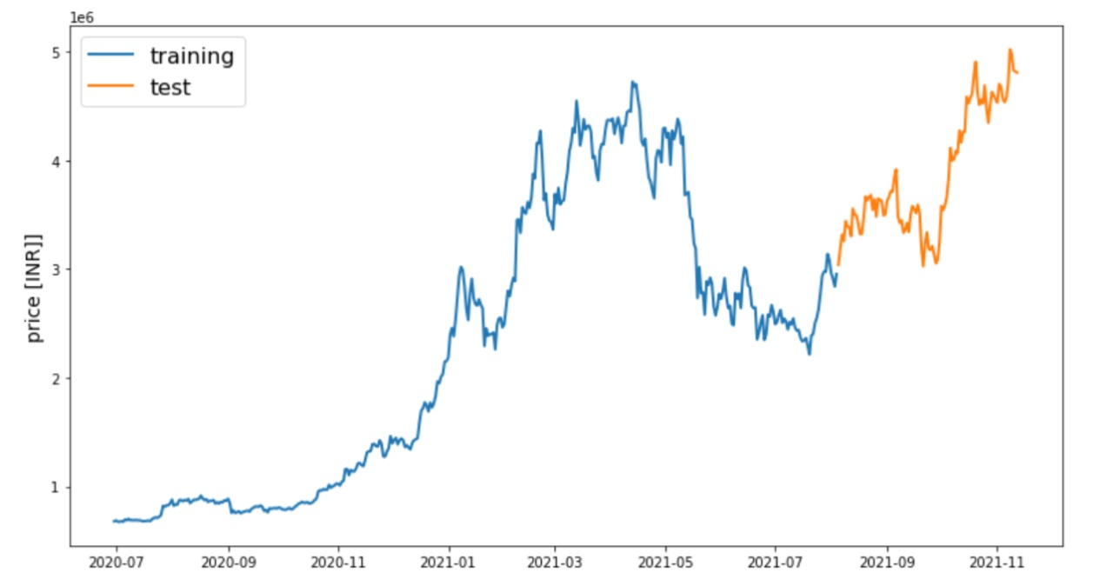
Training and Testing Plot
Train/Test is a method to measure the accuracy of your model. It is called Train/Test because you split the the data set into two sets: a training set and a testing set.
You train the model using the training set. You test the model using the testing set. Train the model means create the model.

Slide 9
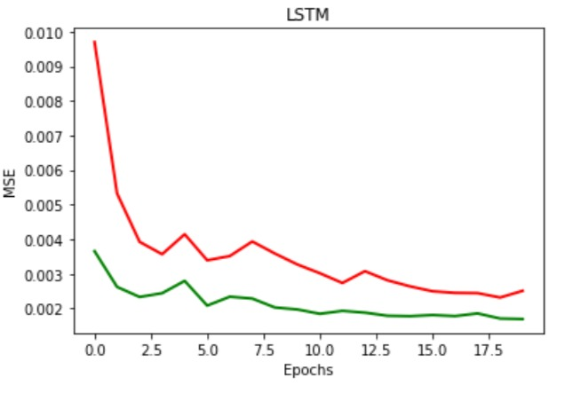
LSTM Plot

Slide 10
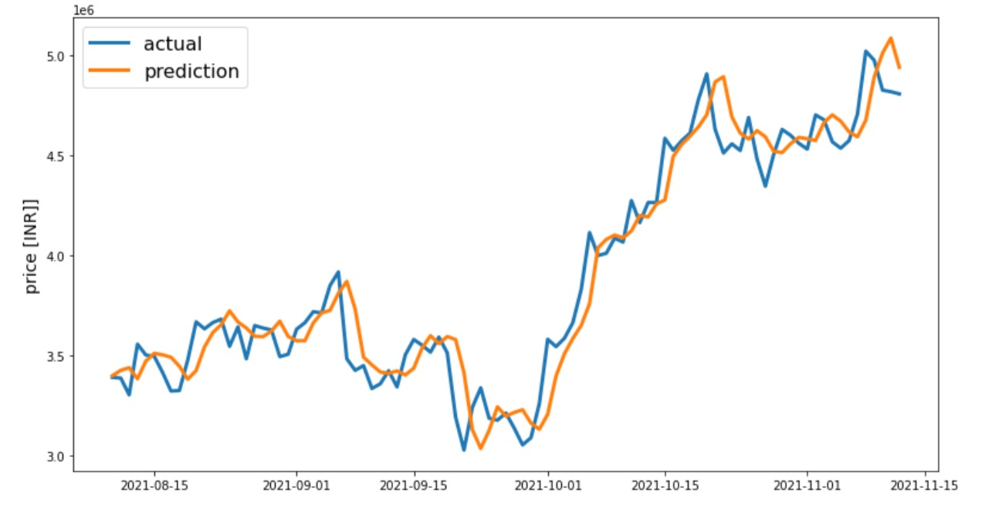
Actual and Prediction plot
Source Code : https://github.com/Meghana592/REVA-HACK-2021/blob/main/crypto_currencypred%20(1).ipynb

Slide 11

THANKYOU!!!!☺
-BY TEAM PHOENIX

